Slide 1

Sixth Form Life & Rules 2024
@6thform_hollyfield
Notes:
DWA
1

Slide 2
Sixth Form Team
Duncan Warren - Head of Sixth Form
Alex Humm - Deputy Head of Sixth Form
Prayagha Siva - Head of Y13
Rob Hall - Head of Y12
Jo Ebsworth - Sixth Form Student Services Manager
Notes:
DWA
2

Slide 3
Ofsted on Hollyfield Sixth Form
“In the sixth form, leaders have planned a transition programme to help students adapt to the demands of advanced study.”
“Students value the support they receive in the sixth form, especially with applications for university. Students achieve well, and they go on to study at a range of universities, including those in the Russell group. “
“Pupils, parents and carers told us they value the amazing range of opportunities available. Sixth-form students like the debates and other enrichment activities. “
Notes:
DWA
3

Slide 4
Below is a list of local sixth forms that Hollyfield outperformed, or in the case of Waldegrave, achieved the same Value Added:
Hollyfield School | 0.05
Waldegrave | 0.05
Glyn | 0.03
Tiffin Girls | 0.02
Esher College | -0.01
Richard Challoner | -0.08
Coombe Girls | -0.12
Holy Cross | -0.37
Coombe Boys | -0.54

Slide 5
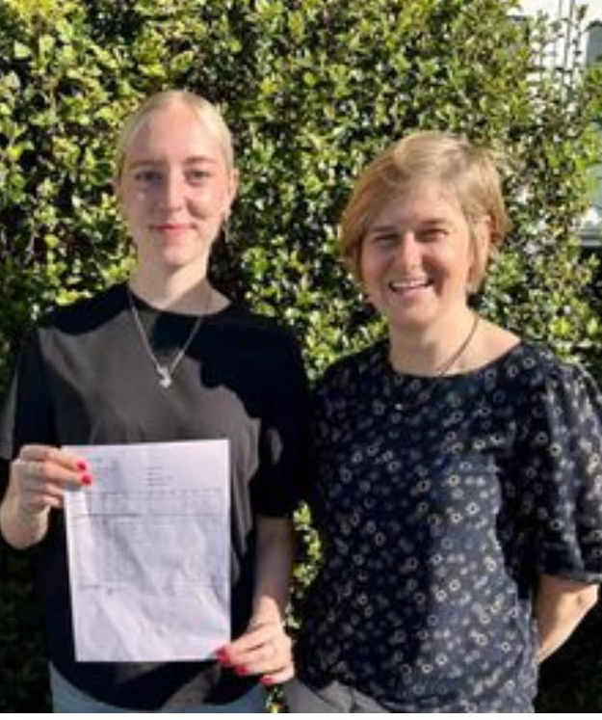
Destinations- Oxbridge Success in a Competitive Year
Willow Walker-Todd
History
Oxford University
Noah Hall
Music
Oxford University
3 students in the last 2 years into Oxbridge

Slide 6
Noah Hall Music at Oxford University AAA
Willow Walker-Todd History at Oxford University AAB
Joe Bannister Veterinary Science at University of Surrey A*A*B
Sam Horner Computer Science at University of Bath A*A*A*
Lana Kaedby Biotechnology at University of Manchester A*AA
Danny Paget Economics at King’s College London A*AAC
Jack Zhou Mechanical Engineering at University of Southampton A*AA
James Frost Gap Year A*AA
David You Natural Sciences at University of Bath A*AAA
Teddy Brewer Project Management Apprenticeship BBC
Notes:
DWA

Slide 7

Over the past 3 years - 40% Students go to Russell Group Universities
University of Birmingham
University of Bristol
University of Cambridge
Cardiff University
Durham University
University of Edinburgh
University of Exeter
University of Glasgow
Imperial College London
King's College London
University of Leeds
University of Liverpool
London School of Economics & Political Science
University of Manchester
Newcastle University
University of Nottingham
University of Oxford
Queen Mary University of London
Queen's University Belfast
University of Sheffield
University of Southampton
University College London
University of Warwick
University of York
Notes:
AHU

Slide 8
Our Vision
Confidence
Worldliness
Work Ethic
Notes:
AHU
8

Slide 9

BTEC / AS / A2
University
GCSE
Notes:
TAL
Now we need to be aware as a school and you as parents about the step up that students make when they go from GCSE to BTEC and AS. If students do not work hard they can get caught out and they need to utilise the time and free periods
But there is some good news the next step if they get to university or into a job or onto apprenticeship is not as demanding
When I started at Liverpool University – the first year did not count towards my final grade and I had covered most of the content.
So it is our job as a school and your job as parents to help students make this step up
9

Slide 10
How do they make the jump?
Effort- 1 hour private study for every hour in the classroom
Organisation- at least one folder for each subject
Independent study
Enrichment – Wednesday afternoons
Utilising free periods – help plan the weeks free lessons with your child
Work/ life balance - Down time / Exercise / Interests / time away from gadgets
Notes:
AHU
10

Slide 11
Expectations
Jobs - not too many hours and not during the school day - 10 to 12 hours max
Students must be on top of:
Google classroom
School email
Classcharts
18 months! Work hard from the start
Students must attend their tutorial time each week - will go through important issues during these sessions
Medical appointments must not be during lessons
Driving tests are ok but driving lessons outside of school hours
Lateness logged on ClassCharts
Notes:
PSI
11

Slide 12
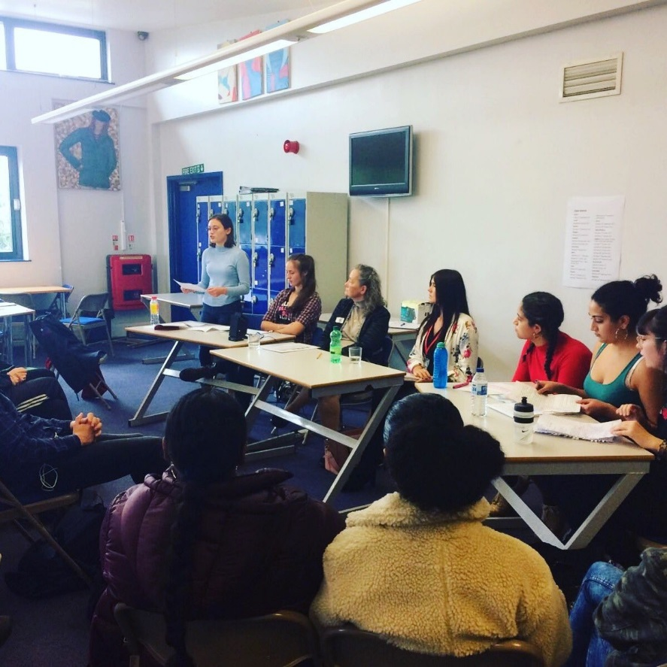
Structure of the week
Monday 8:30 am -
Compulsory Briefing /assembly and key information 8.30am
Wednesday P5 and P6 - Enrichment
Tutorial - 1 X 50 minute session per week
Notes:
PSI
12

Slide 13
95% Attendance
We may ask students to work in school from 8- 4 every day if
attendance drops below 95%
work is not being submitted
student is behind on coursework
If your son/daughter is unwell or is going to be absent please use the direct 6th form line - 0208 339 4507 or email - jebsworth@hollyfield.kingston.sch.uk
Notes:
PSI

Slide 14
Paid Opportunities for Students
We have a number of paid opportunities for our Sixth Form students.
Science Teaching Assistant
Community Language Assistant
MFL Teaching Assistant
Facilities Support
Painting and Decorating
KS3 Mentoring
Homework Assistant
Lunch Duty
Lower school 1-2-1s
IT Technician
Notes:
PSI

Slide 15
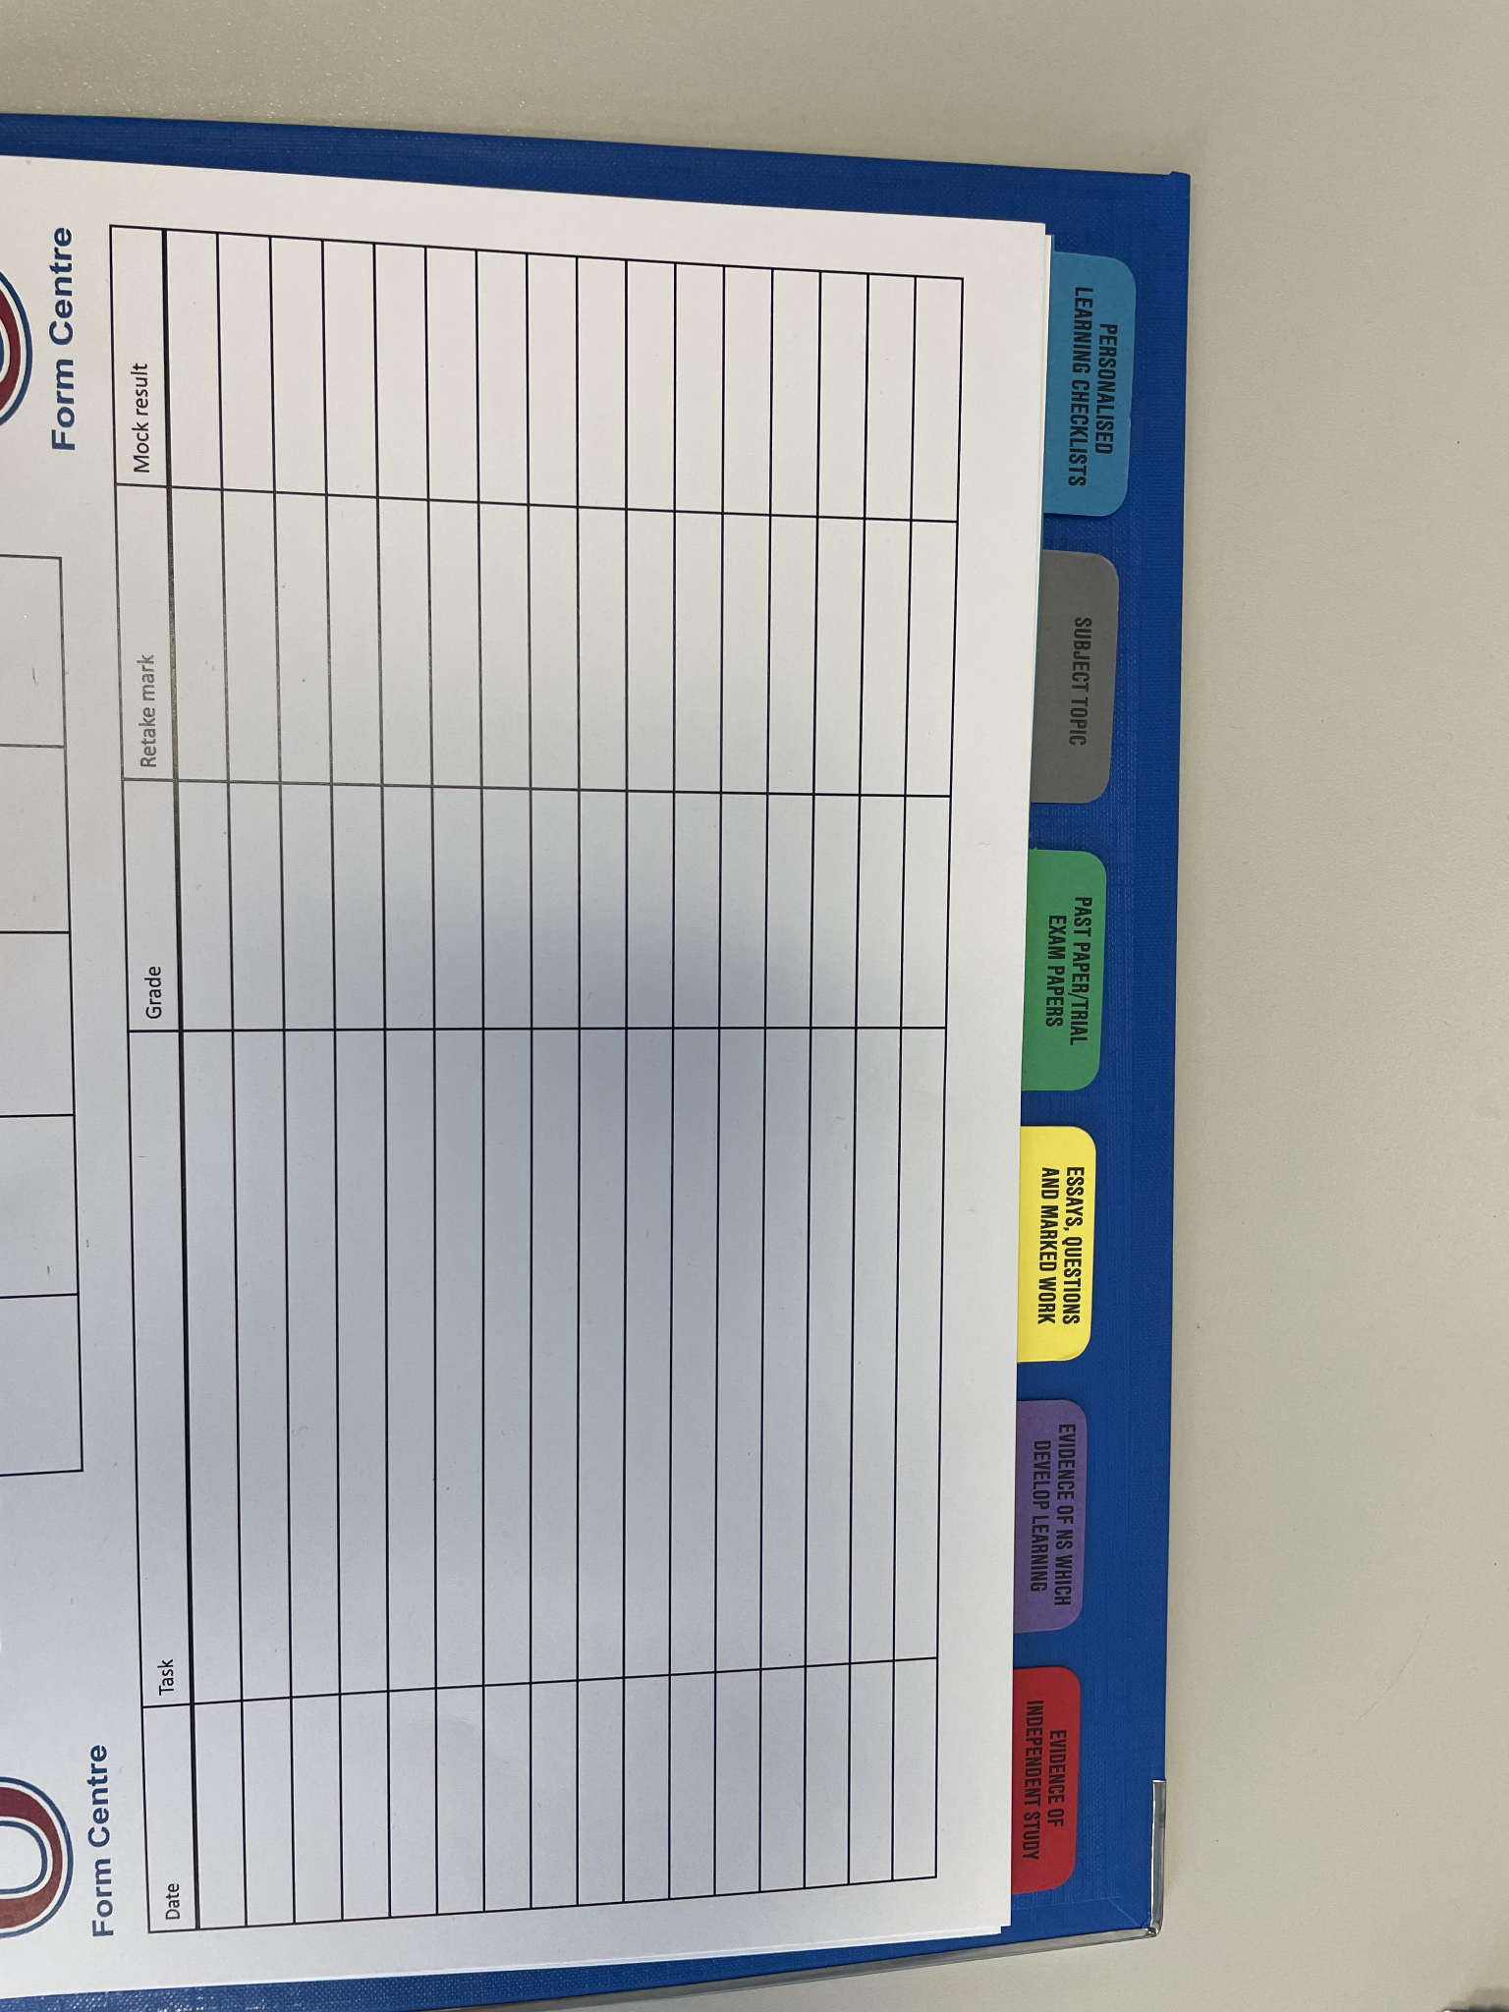
Sixth Form Folders
Assessment Tracker
Sixth Form Termly Feedback Sheet
PLCs (Personalised Learning Checklists)
Subject Topic Dividers
Past paper/ Trial Exam Papers
Essays, Questions and Marked Work
Evidence of NS which Develop Learning
Evidence of Independent Study
Notes:
RHA

Slide 16
Key Points
Exceptions are: Art, Product Design, Photography, Media
Students can have exercise books as well
The students do not need to bring the folders in every day
The cost of the folders is £5.50 each inclusive of the dividers and inserts.
Exception is students who were free schools meals or bursary
Notes:
RHA

Slide 17
Y12: Structure of the Year
Oct 2024 - Y12 Readiness Review (4 week review)
Jan 2025 - All Y12 students Walking Talking Mocks
Jan 2025 - Trial Exams 1
All students down to 3 subjects
Apr 2025 - Trial Exam 2
Jun 2025 - Y12 End of Year Examination
Summer Term - Y12 Work Experience
Notes:
DWA
17

Slide 18

Oxbridge and Medical Sciences Programme
Oxford, Cambridge, Imperial, Medicine and Veterinary Sciences.
Open days and visits
GCSE grades 8-9
Interview support
Admissions tests prior to application
Check each university website for their admissions tests
Notes:
AHU

Slide 19


University and Apprenticeship Information Evening – May 1st 2025
Notes:
AHU
19

Slide 20
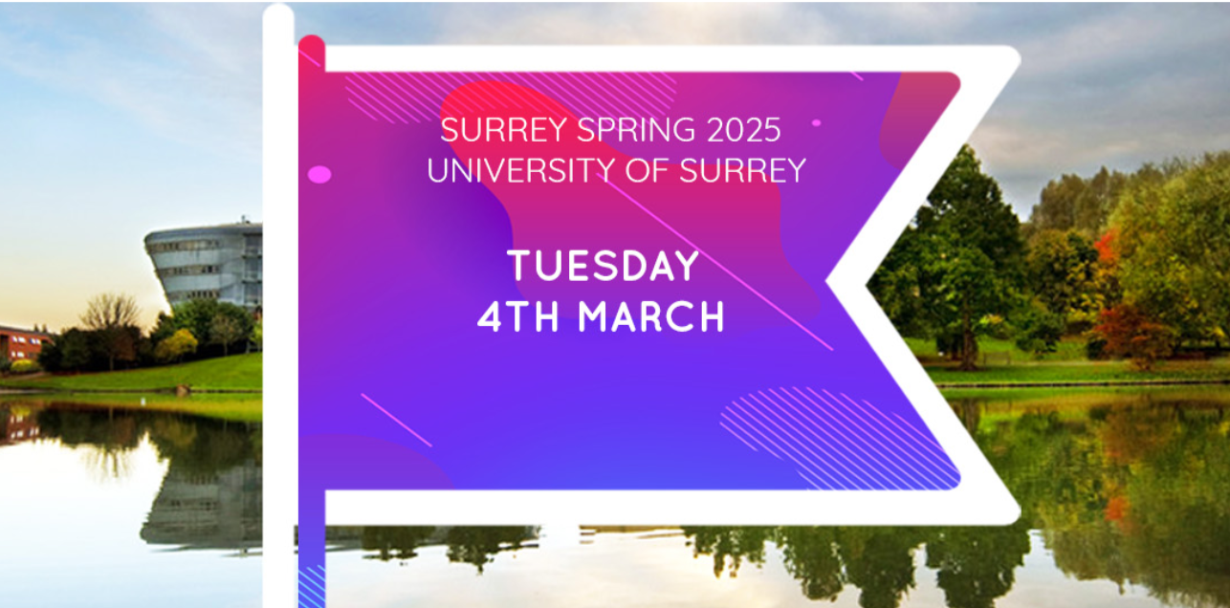
University and Apprenticeship Fair
University of Surrey - March 2025
Notes:
AHU

Slide 21
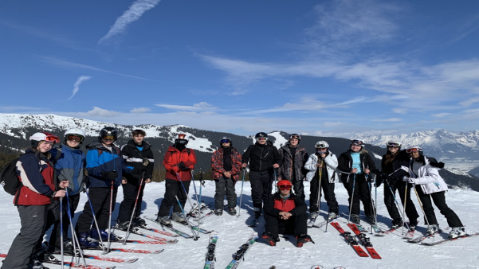
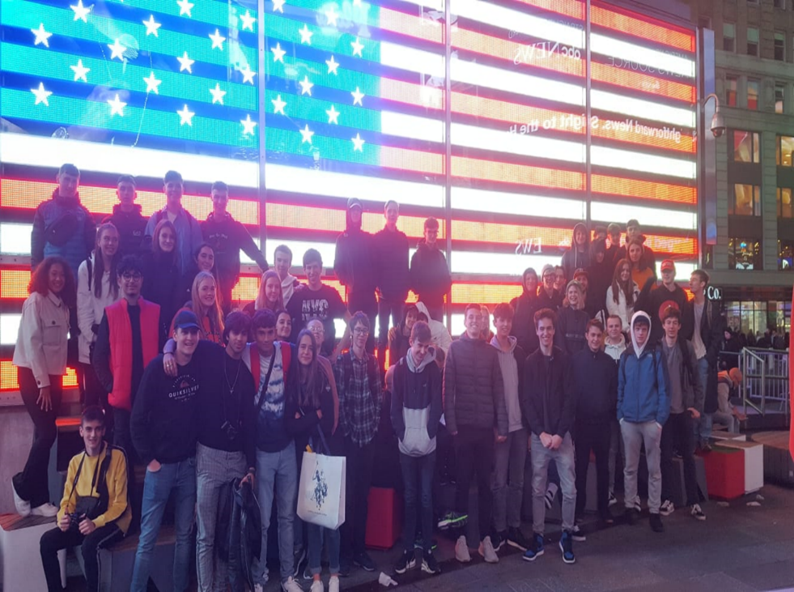
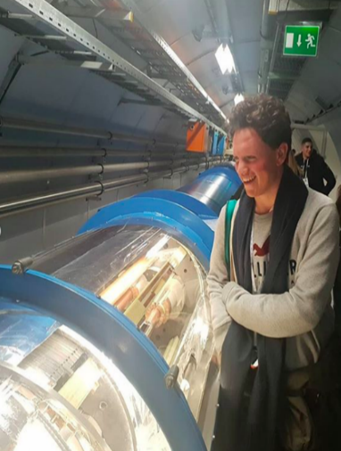
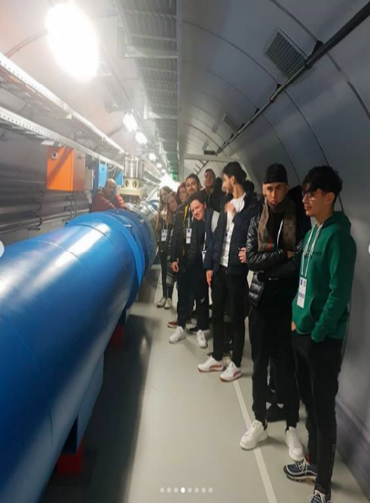
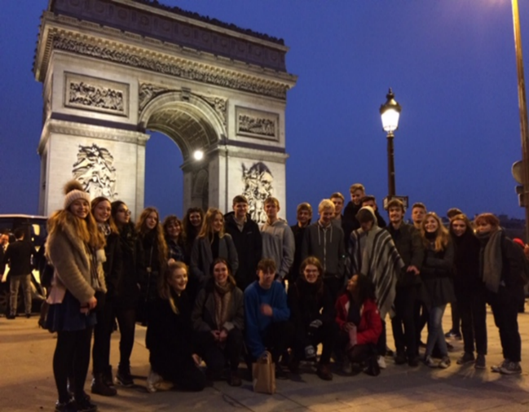
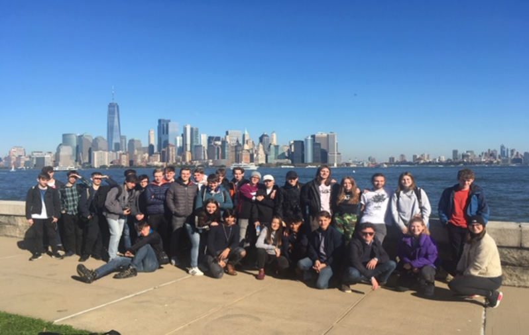
6th Form Trips
- Paris
- Ski Trip: Going to be announced next week
- Geneva: CERN
- New York and Washington
Notes:
Now that leads on to trips
In the Summer we do a trip to Prague to look at the Culture, History and Beauty of amazing city
These trips are open to all and make Holyfield an exciting place to study.
If you are concerned about financial cost of these trips we have a bursary fund which can help all pupils of all backgrounds to go on these trips.
21

Slide 22
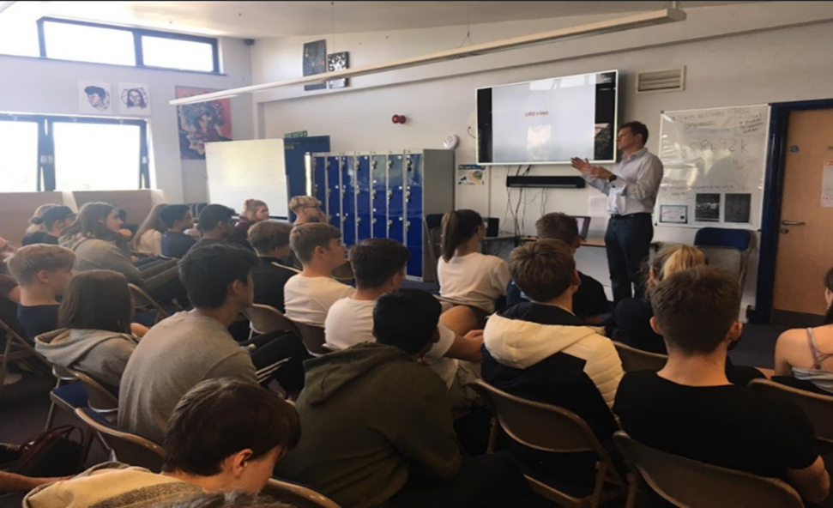
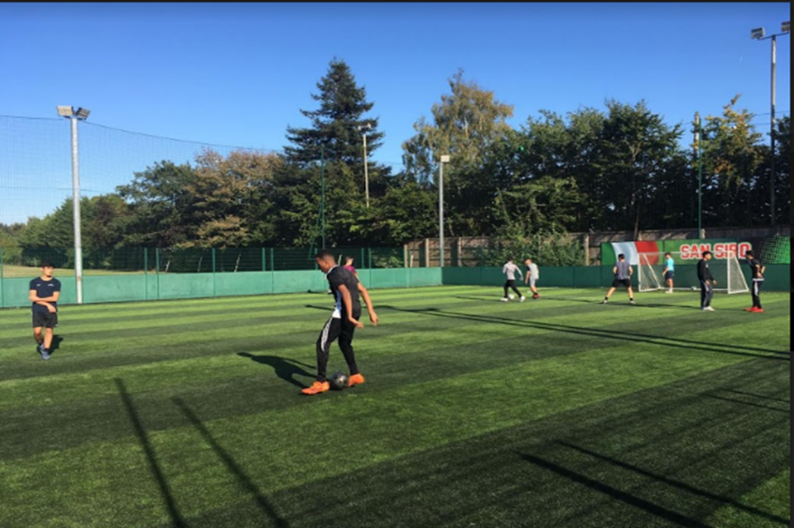
Enrichment- get involved
Go Ape - All Y12
Guest Speakers
Football
Netball
Badminton
Rugby
Debates
Cooking for Uni
Young Enterprise
Film Club
Board Game Club
Political Hustings
Trips
Every Wednesday !
Notes:
RHA

Slide 23
WEX & Volunteering
Compulsory requirement in Y12 for entry into Y13
Takes place in Summer term
Students seek own placements
Cannot be paid P/T jobs
Informs UCAS/ Personal statements
Some date flexibility
Notes:
RHA
23

Slide 24
Q & A

